Slide 1


GS Academy
Service Delivery Excellence
10/20/20
Notes:
Use the correct date of the session.

Slide 2


Introductions
Tues 10/20
Marvin Johnson
Tina Soares
Notes:
Use images from slide 34/35 for each session
Replace the boxes with headshots of the facilitators and producer.
Headshots can be found on Workday>click their profile image>Save As
Show this slide as you're doing introductions.

Slide 3



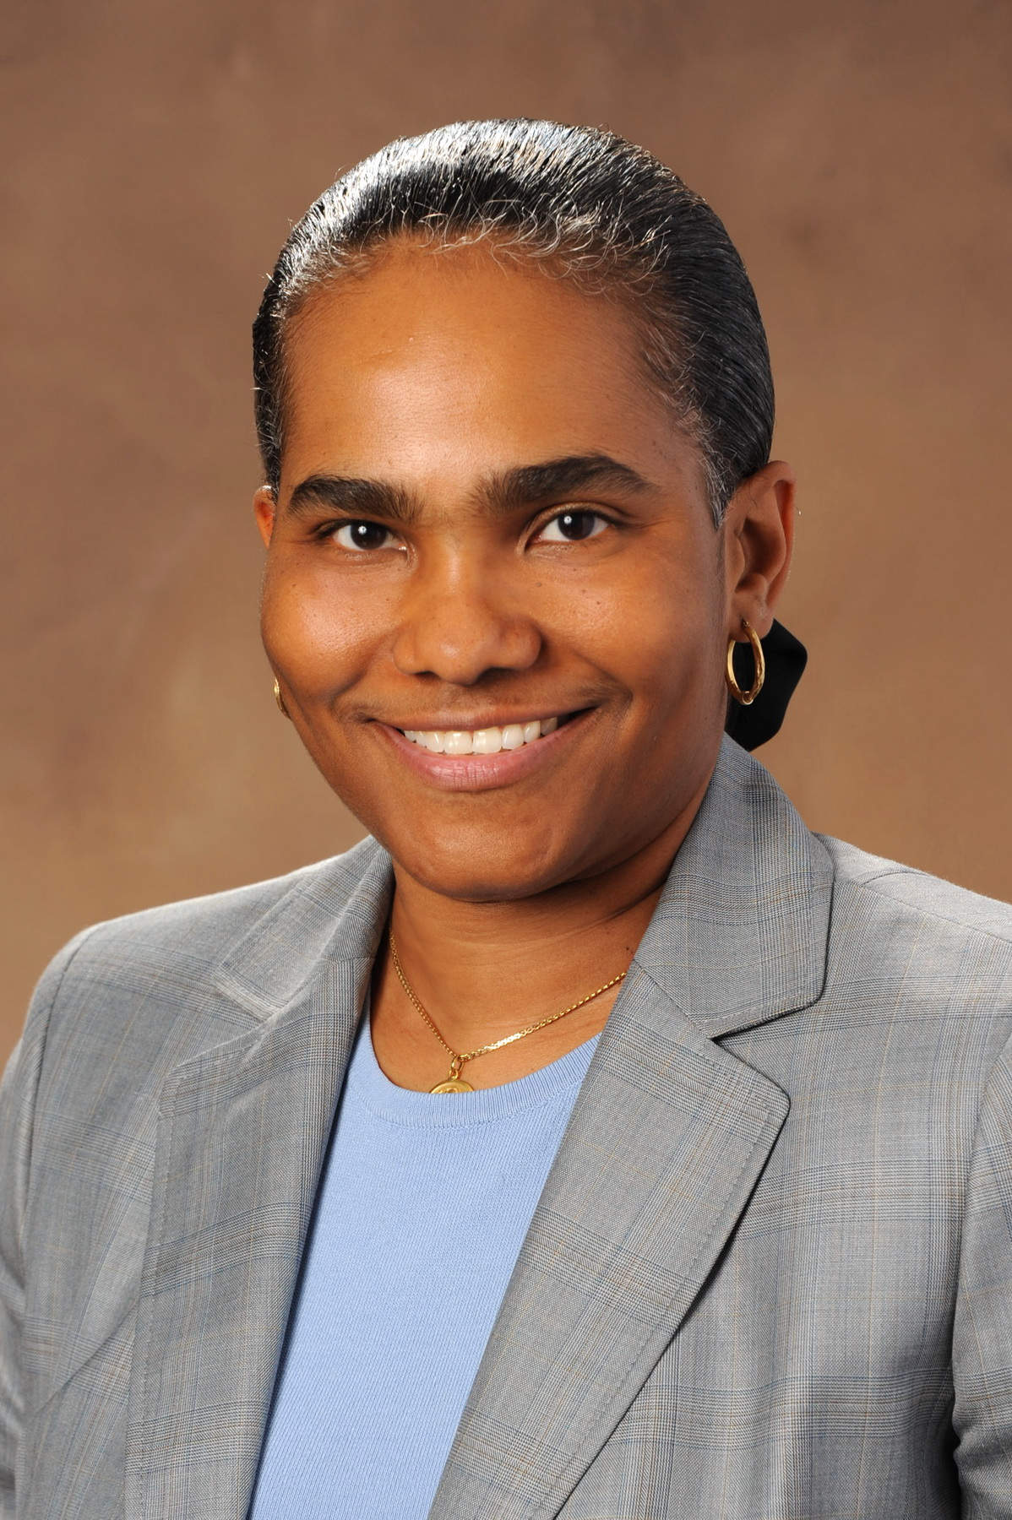
Cameo Appearances
GSLT members sharing their perspectives
Dave Crutchfield
Julian Hooks
Noel Fairbanks
Ginelle Julien-Jackson​
Global Head, People Experience and HR Service Delivery
VP, Procurement Shared Services and Operations​
VP, GS Finance Service Delivery and Experience​
VP, Service Excellence and Experience​
Notes:
Show this slide as you're doing introductions.

Slide 4


How to Engage
Use the chat to submit questions or comments throughout the session.
Use the hand raise feature to use your audio and share with the group.
Notes:
Encourage members to use the chat to submit questions or comments throughout the session or ask other attendees questions.
The producer will manage the chat and take note of questions to bring it to the attention to the facilitator during Q&A sections.
Here are resources about the chat features in Zoom.
Finally, attendees can use to the hand raise feature if they want to use their audio and share with the group.

Slide 5
Why are you here today?
Goal:
Share and build upon our experience and knowledge of Service Delivery Excellence as well as how GS measures performance.
Key Points:
Who do we serve and how do we show our customers they come first?
How does GS commit to Experience, Efficiency & Effectiveness in everything we do?
How does GS strive to find new opportunities to drive value for the organization and the business partners we support?

Slide 6

What does Service Delivery mean to you?
Notes:
https://pollev.com/gsacademy618

Slide 7

How would you define Service Delivery Excellence?
Notes:
Focus on excellence. Not just ordinary service.
https://pollev.com/gsacademy618

Slide 8

Notes:
GSLT Define Video

Slide 9
Service Delivery
Providing an exceptional experience to our J&J employees and ultimately, our patients, customers, and consumers.
An end-to-end mindset is critical to delivering customer-centric solutions and providing seamless, standardized services.

Slide 10

What are the current services we provide today?

Slide 11







Global Services connects our businesses and
empowers employees to leverage the scale of J&J
Our Current Services
Finance
Procurement
Human Resources
Multi-Functional
Account to Report
Invoice to Cash
Payroll
Expense Reporting & Reimbursement
Master Data Management (MDM)
Requisition to Pay
Sourcing & Supplier Management
Supplier Contracting
Spend Analytics & Reporting
Talent Acquisition
Employee Relations Management
Workforce Administration
Total Rewards
BPO Supplier Management
Compliance
Contact Center
Learning Management
Enterprise Transformation
Service Enablers
Change Management & Communications
Business Engagement
Value Marketing
Service Experience
Portfolio and Process Management
Service Improvement
A&D Support
Global Site Operations
GS Data Strategy & Governance
Reporting and Business Insights
© Johnson & Johnson Services, Inc. 2019

Slide 12

GS Customers
Who do we support?

Slide 13







GS Customers
Internal J&J Customers
External Customers
Business Unit
Employees
(Consumer, Medical
Device, Pharma)
Corporate/
GS Employees
Supply Chain Employees
Vendor/
Suppliers
Retirees
J&J Contractors
Gov’t/ HCP
Notes:
Any J&J employee- FTE
Contractor- Non-FTE worker
Vendor- Provides a service
Supplier- Provides materials
Internal business partners- Cross-tier or cross-functional support (GS helping GS)
Corporate/BU partners- Leaders or partners outside of GS (could be executive or senior level)

Slide 14
Notes:
Ginelle Video

Slide 15

How do you learn about and stay connected to your customers’ needs?

Slide 16

GS Metrics
How do we measure the success
of the services we offer?

Slide 17
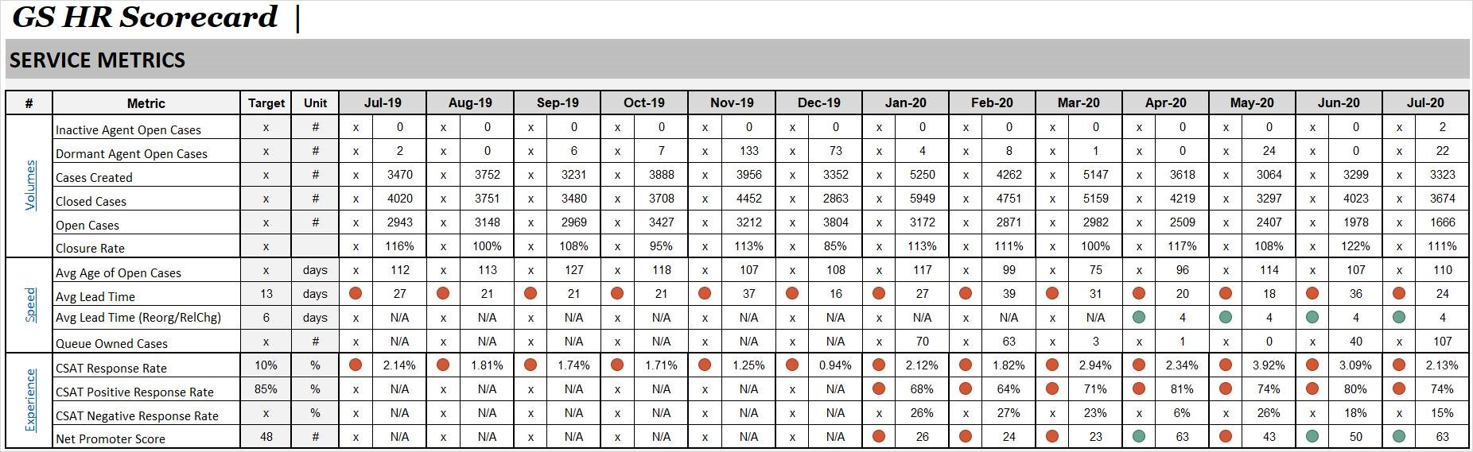
Monthly Business Report (MBR)

Slide 18
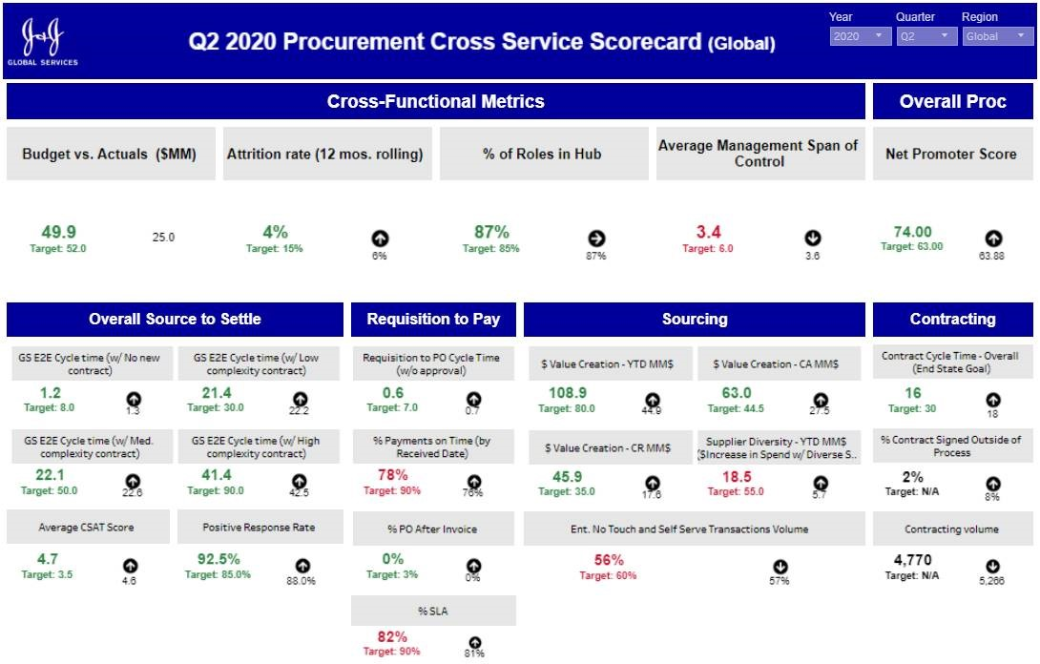
Quarterly Business Report (QBR)

Slide 19
GS Executive Scorecard

Slide 20
Cost To Serve
What it costs GS to deliver our services

Slide 21
Value Creation/Innovation
Savings that GS brings to the business

Slide 22
Service Quality
How well we deliver a service, how well we commit to what we deliver, and how often we deliver on time

Slide 23
Customer Experience/Satisfaction
Feedback from customers on how easy and enjoyable the experience was

Slide 24
Talent & Culture
GS lives our Credo; develops employees to grow; and brings the right talent

Slide 25
Notes:
Dave Video

Slide 26
Dave’s Top Metrics

Slide 27






Personalization
Greet me, Know me, Recognize our history
Integrity
Expectations
Resolution
Time & Effort
Empathy
6 Pillars of Customer Centricity
Personalization
Empathy
Listen to me, Show me you care, Take ownership of my issue
Integrity
Do what you say, Be competent, Be likable
Time & Effort
Minimize my effort, Provide me answers, Be simple & clear
Expectations
Set my expectations, Guide me, Exceed your promises
Resolution
Give me a sincere apology, Go the extra mile, Own the resolution
Notes:
There are 6 pillars of customer centricity.
As an organization, if we can get these 6 things right –not sometimes, but every time - our customers will have an excellent experience.
The first, is personalization. Greet me, know me, recognize our history.
Know a little bit about me. Am I a new hire that is struggling through onboarding? Am I an employee of a newly acquired company that is trying to figure out how to navigate J&J? Do I have open cases? Have I recently contacted GS about my open case? Know a little bit about me to imagine my perspective as your getting ready to interact with me.
The second is integrity. Do what you say, be competent, be likeable.
Follow through on what you say you’ll do. Prove that you are trustworthy and reliable.
The third is expectations. Set my expectations, guide me, exceed your promises.
Set expectations with me up front and then deliver against those expectations. Will my request take 2 weeks to deliver? Tell me that during our initial interaction, explain why, and then ensure my request is actually delivered in 2 weeks (or less!)
The fourth is resolution. Give me a sincere apology, go the extra mile, own the resolution.
Work to completely resolve my case the first time. And when that doesn’t happen – apologize for the mistake and quickly make it right.
The fifth is time & effort. Minimize my effort, provide me answers, be simple & clear.
Recognize that I have a job to get back to and do anything you can to make it easier and faster for me.
And, last but certainly not least, is empathy. Listen to me, show me you care, take ownership of my issue.
In our interactions, show me you care about what I’m going through. Acknowledge that my situation might be frustrating, upsetting, exciting – and ensure you provide appropriate support along the journey.
Additional Notes:
Source: Adapted from KPMG

Slide 28
Notes:
Noel Video

Slide 29

Wrap Up
Key Takeaways and Q&A

Slide 30
Key Takeaways
Our customers come first and expect excellence.
GS commits to Experience, Efficiency & Effectiveness in everything we do.
GS strives to find new opportunities to drive value for the organization and the business partners we support.

Slide 31
Notes:
Julian Video

Slide 32

Q&A

Slide 33
Join us on Yammer!
How do you share successes or best practices?
Notes:
https://web.yammer.com/main/threads/eyJfdHlwZSI6IlRocmVhZCIsImlkIjoiODU3ODM1MzA0NDkzMDU2In0

Slide 34
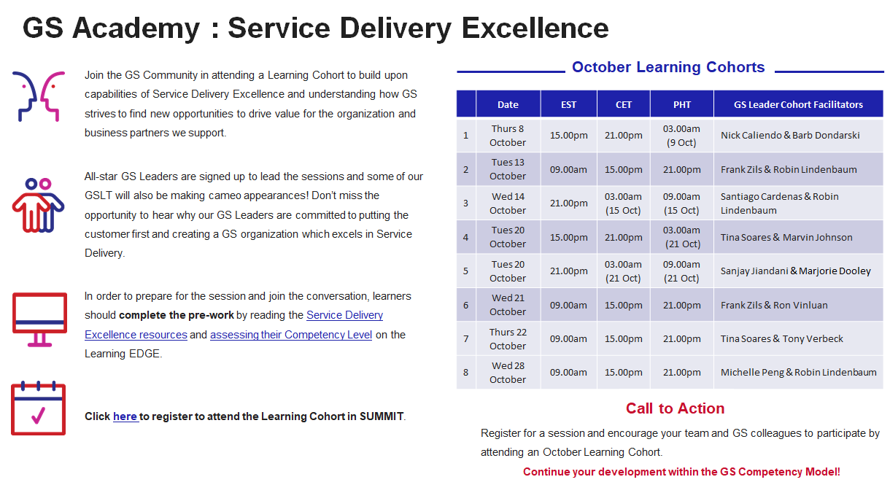

Slide 36
Introductions
Who’s who?
Use slides 35+ for the correct intro slide. Remove the hidden feature by right clicking on the slide and select Hide Slide.
Select the correct slide for each session.
Notes:
Use images from slide 34/35 for each session
Replace the boxes with headshots of the facilitators and producer.
Headshots can be found on Workday>click their profile image>Save As
Show this slide as you're doing introductions.

Slide 37

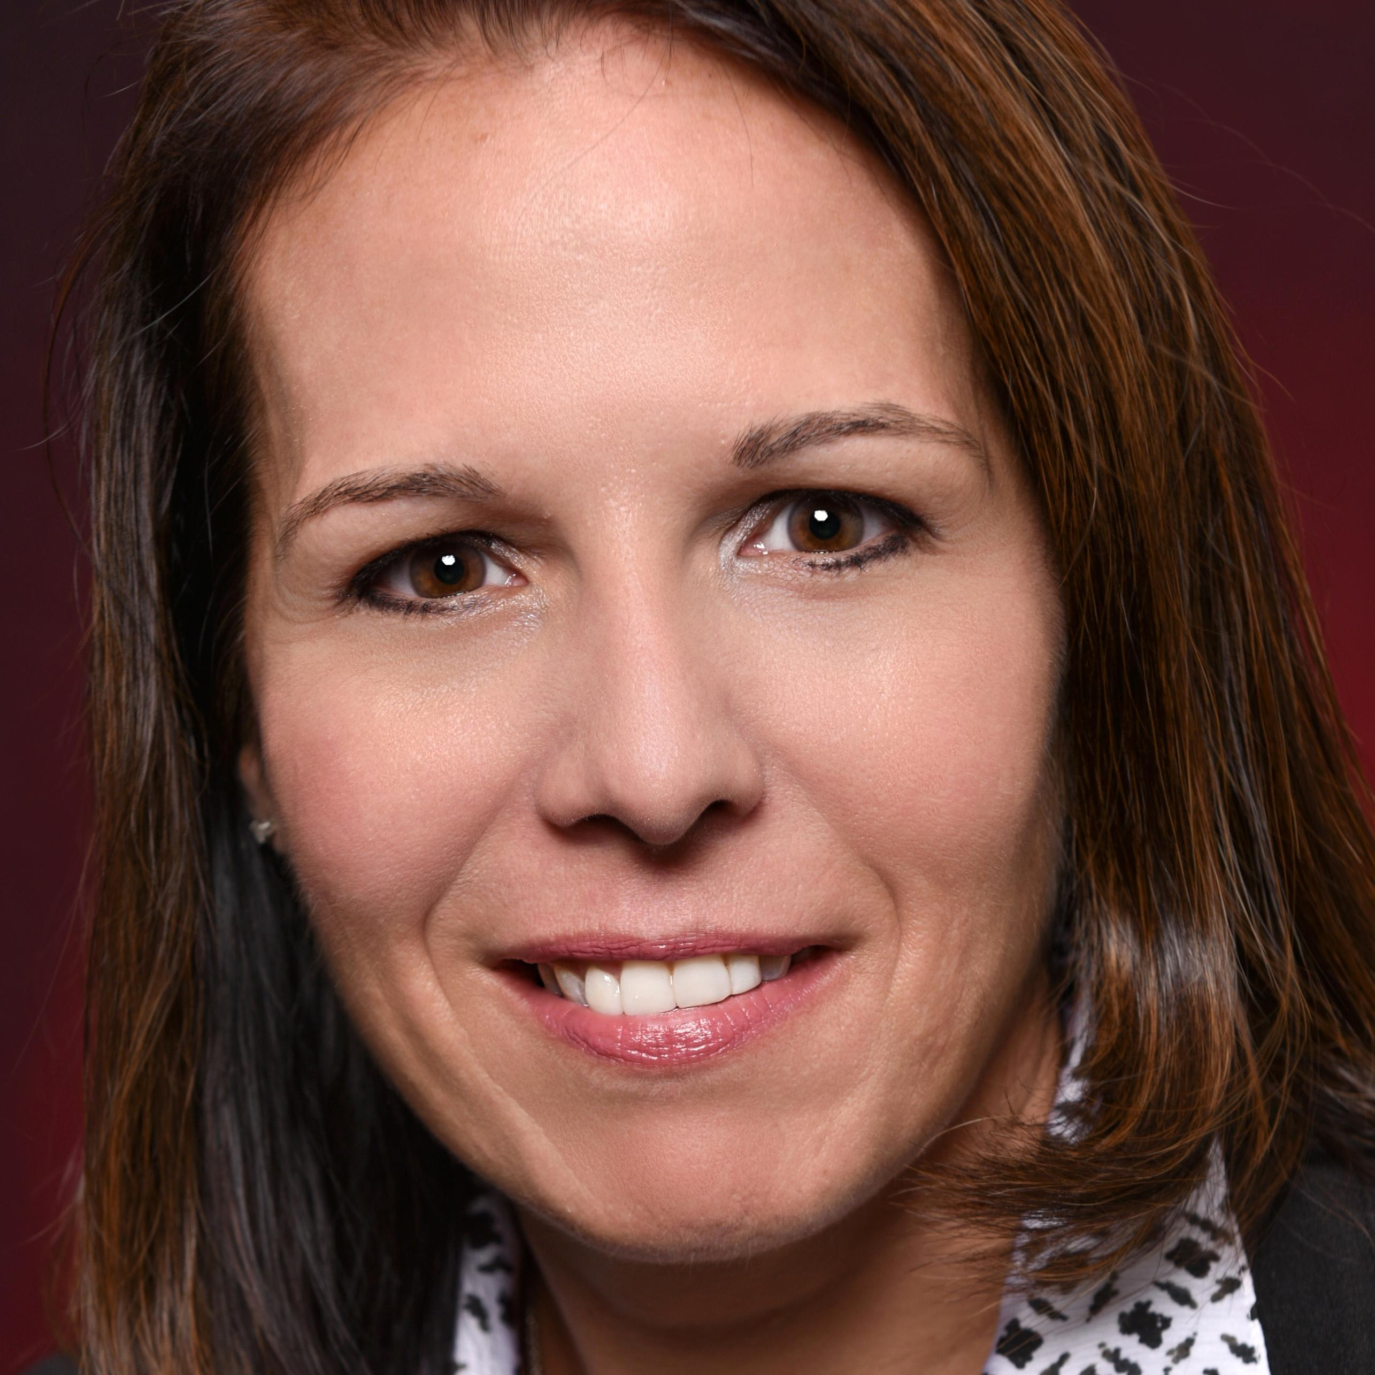
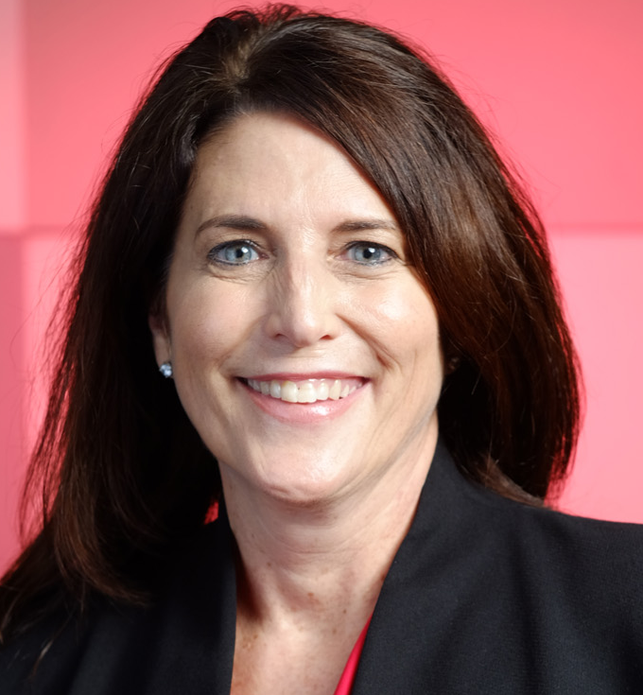
Introductions
Wed 10/8
Nick Caliendo
Barb Dondarski
Lisa Anisman
Notes:
Use images from slide 34/35 for each session
Replace the boxes with headshots of the facilitators and producer.
Headshots can be found on Workday>click their profile image>Save As
Show this slide as you're doing introductions.

Slide 38



Introductions
Tues 10/13
Robin Lindenbaum
Frank Zils
Stacy Heintz
Notes:
Use images from slide 34/35 for each session
Replace the boxes with headshots of the facilitators and producer.
Headshots can be found on Workday>click their profile image>Save As
Show this slide as you're doing introductions.

Slide 39
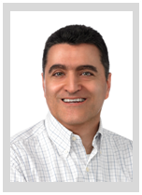
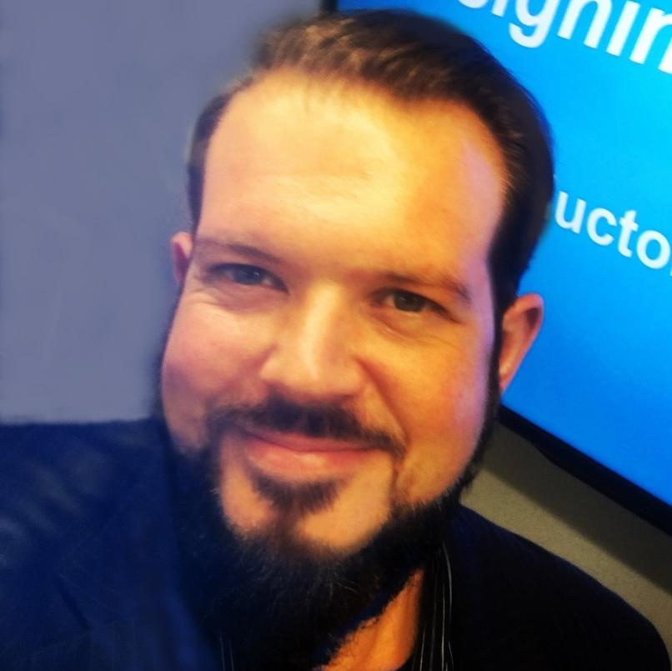
Introductions
Wed 10/14
Santiago Cardenas
Robin Lindenbaum
Dave Rasmussen
Notes:
Use images from slide 34/35 for each session
Replace the boxes with headshots of the facilitators and producer.
Headshots can be found on Workday>click their profile image>Save As
Show this slide as you're doing introductions.

Slide 40
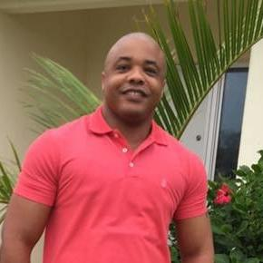
Introductions
Tues 10/20
Marvin Johnson
Tina Soares
Darrell Clark
Notes:
Use images from slide 34/35 for each session
Replace the boxes with headshots of the facilitators and producer.
Headshots can be found on Workday>click their profile image>Save As
Show this slide as you're doing introductions.

Slide 41

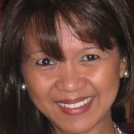
Introductions
Tues 10/20
Sanjay Jiandani
Marjorie Dooley
Dave Rasmussen
Notes:
Use images from slide 34/35 for each session
Replace the boxes with headshots of the facilitators and producer.
Headshots can be found on Workday>click their profile image>Save As
Show this slide as you're doing introductions.

Slide 42
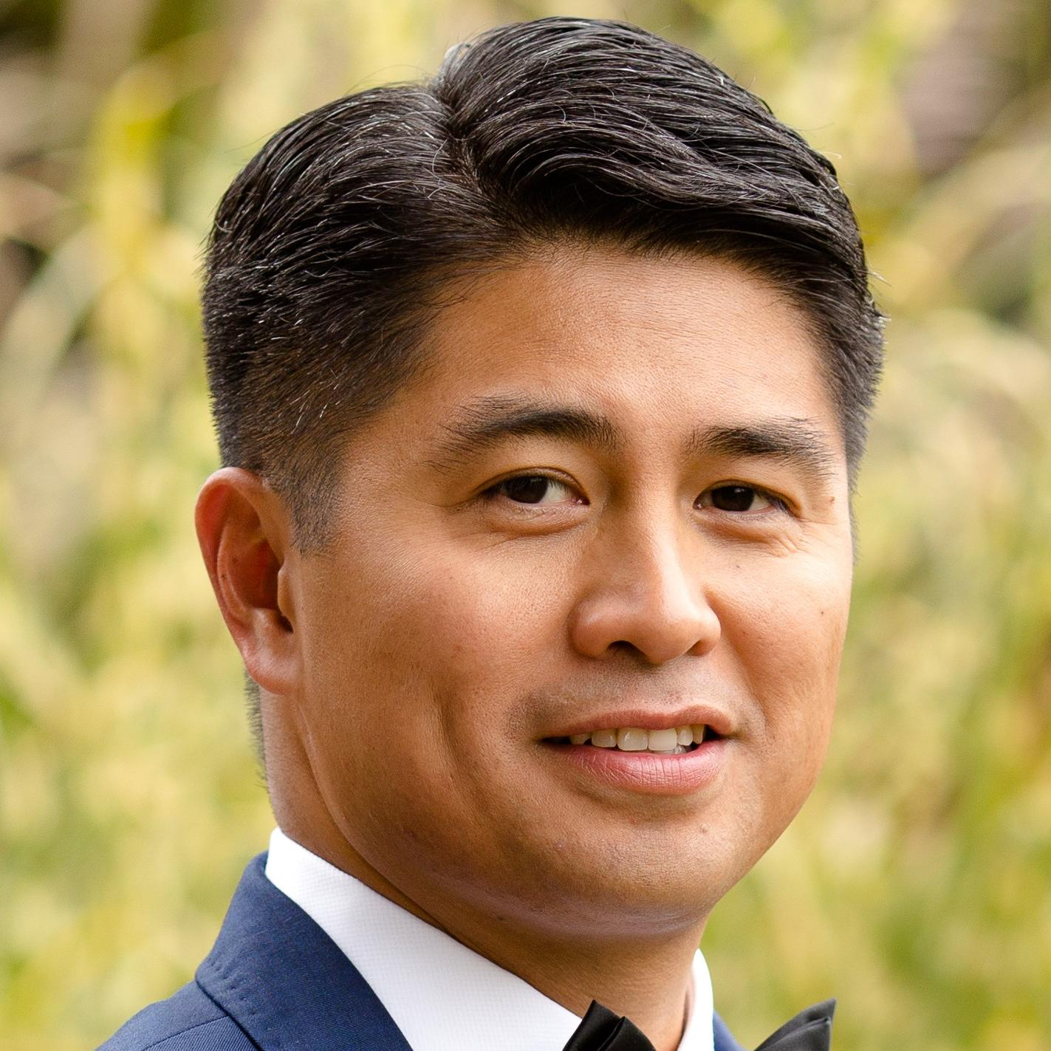
Introductions
Wed 10/21
Ron Vinluan
Frank Zils
Lisa Anisman
Notes:
Use images from slide 34/35 for each session
Replace the boxes with headshots of the facilitators and producer.
Headshots can be found on Workday>click their profile image>Save As
Show this slide as you're doing introductions.

Slide 43

Introductions
Thurs 10/22
Tina Soares
Tony Verbeck
Dave Rasmussen
Notes:
Use images from slide 34/35 for each session
Replace the boxes with headshots of the facilitators and producer.
Headshots can be found on Workday>click their profile image>Save As
Show this slide as you're doing introductions.

Slide 44
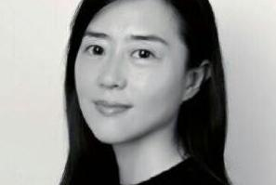
Source Images
Use this slide as a source to swap out images as needed for each session
Notes:
Top row- left to right: Marvin, Michelle, Barb, Nick
Bottom row- left to right: Robin, Frank, Santiago, Tina

Slide 45
Source Images
Use this slide as a source to swap out images as needed for each session
Notes:
Top row- left to right: Sanjay, Ron V, Tony, Marjorie

